Slide 1


1
Graduation Project ENCS5300
Automated Writing Evaluation in Arabic Language
Prepared by:
Diaa Maali
Aseel Khaseeb
Zainab Shaabneh
Supervised by:
Dr. Abualseoud Hanani
31 JULY 2023

Slide 2

2
1
Introduction
Outline
Related Work
Methodology
2
3
Experiments and Results
4
Conclusion & Future Work

Slide 3
Introduction

Slide 4

3
Motivation and Overview
Writing skills evaluation
Traditional writing evaluation
NPL technology.
natural language processing and deep learning.
Numerous studies for the English language.
Arabic AES systems are restricted to short-answer . machine learning .

Slide 5

Applications
Schools
Universities
publishers
scale exams.
editors
journalists

Slide 6

Problem statement
• Long time
• Much effort
• prone error

Slide 7

Project Objectives
Review sufficient
Collect Sufficient
Assessment is done by expert
Analyze the collected data
State-of-art techniques in (NLP)
Experiments
Compare result

Slide 8

Related Works

Slide 9

In 2014, Alghamdi et. al.
above 1500 essays.
Word2Vec, the structure, and meaning of Arabic text with K-Fold cross-validation
accuracy of 85.35.

Slide 10
2. Nest Thermostat
In 2020, Abeer Alqahtani et. Al
SVR algorithm .
five criteria scores; spelling, structure, coherence, style, and punctuation marks.
200 essays.
96% accuracy.

Slide 11
Methodology

Slide 12
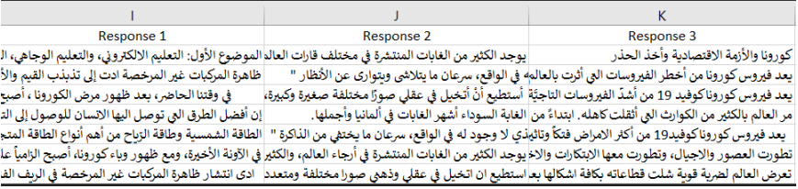
570 essays
250 words
the overall grade is 30
Data set collection

Slide 13
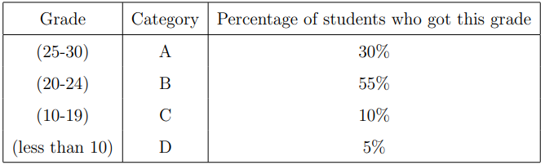
The course instructor( Ph.D. )
spelling mistakes
grammar errors
structure,coherence
level of coherence
style
punctuation
Data set evaluation

Slide 14
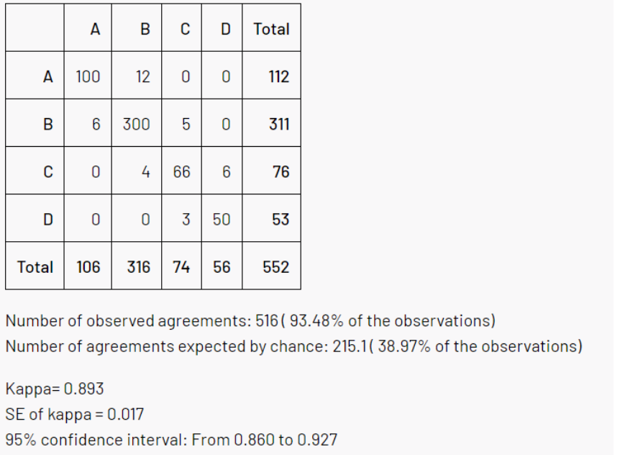
Kappa-Test
Kappa-Test

Slide 15
Language writing assessment
criteria
Surface features
Sentiment features
Coherence features
Spelling features
Punctuation marks

Slide 16
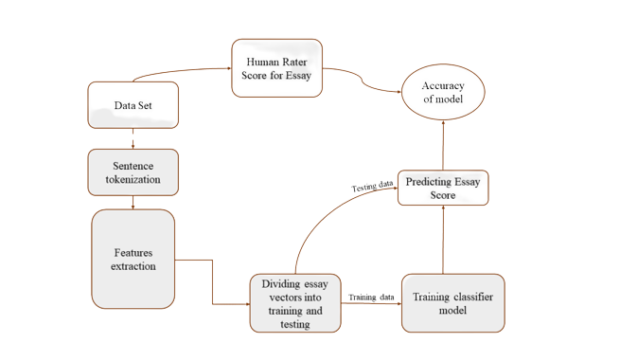
System Overview

Slide 17
Classification models
Artificial Neural Network
Decision Trees
Random Forest
Support Vector Machines
Gradient Boosting Classifier

Slide 18
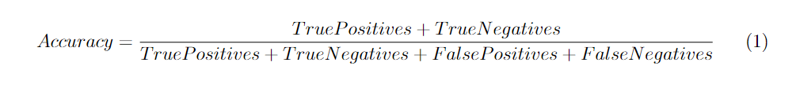
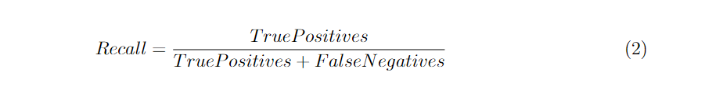
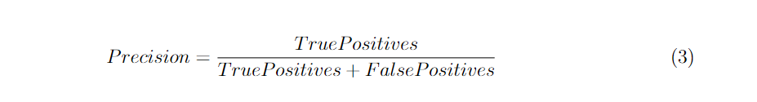
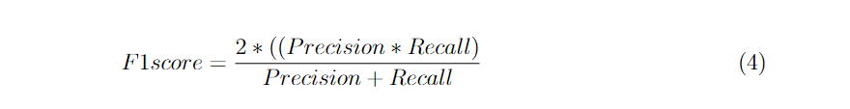
System performance metric

Slide 19
Experiments &
Results

Slide 20
Libraries

Slide 21
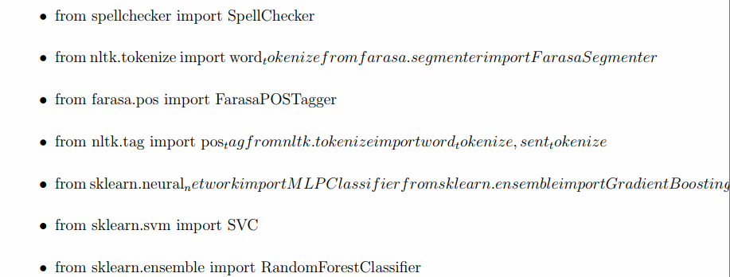
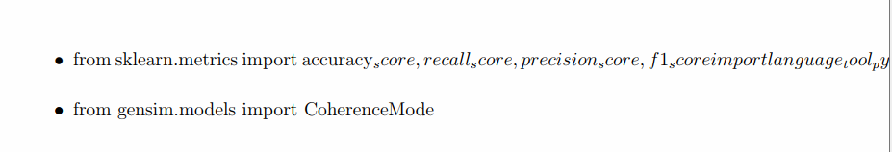

Slide 22
Features computation
numWordsList = len(words)
numSentences = len(sentences)
readability = 0.39 * (num-words / num-sentences) + 11.8 * (syllables / num-words) - 15.59
Sentiment score for each text using the SentimentIntensityAnalyzer from NLTK
avgWordLength = totalLength / numWords
avgSentLength = totalSentLength / numSentences
errors = len(tool.check(text))
type-token-ratio = len(unique-words) / num-words
The coherence score is obtained using cosine similarity between the TF-IDF vector representation of each text and the title .
num-spelling-errors = len(misspelled)

Slide 23
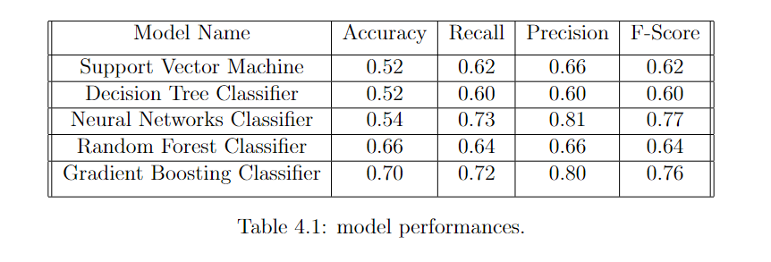
Results

Slide 24
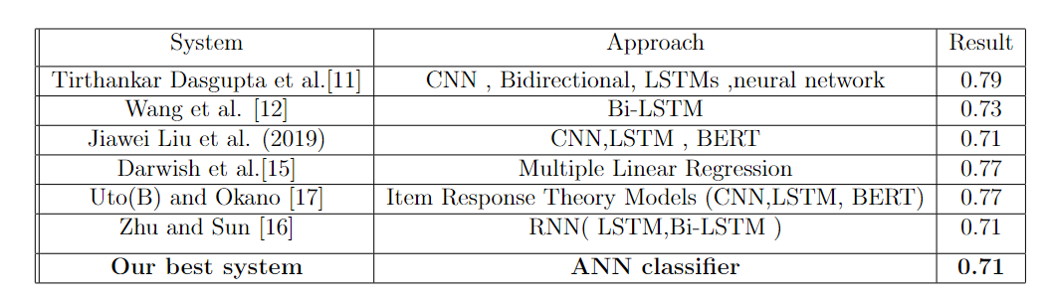
Comparison of results.

Slide 25

24
Conclusion
&
Future Work

Slide 26

Conclusion
our project aimed to classify text essays accurately using different machine-learning models.
A consistent set of 20 features was used across all experiments for fairness and comparability.
The results showed that the Gradient Boosting Classifier achieved the highest accuracy (0.71) due to its boosting technique.

Slide 27

Future Work
increasing the number of the data set.
Increasing the number of features.
trying to distribute the data set into classification groups so that there is fairness in the evaluation.
using libraries of natural language processing (NLP) technologies.

Slide 28
Thank You
QUESTIONS?

